Slide 1
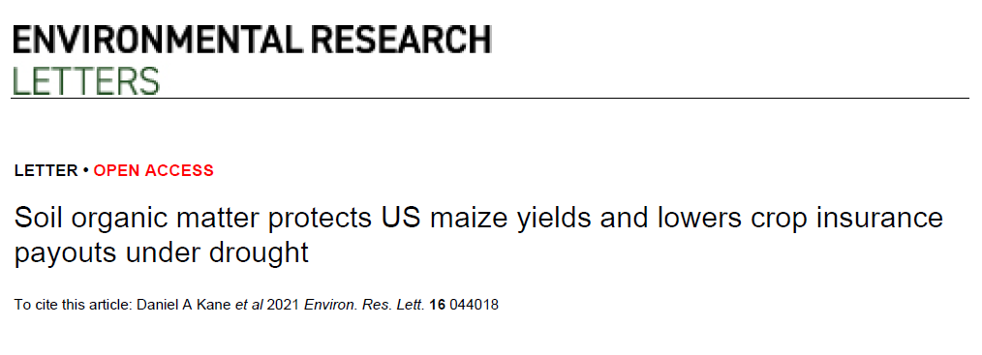
Causal language?

Slide 2
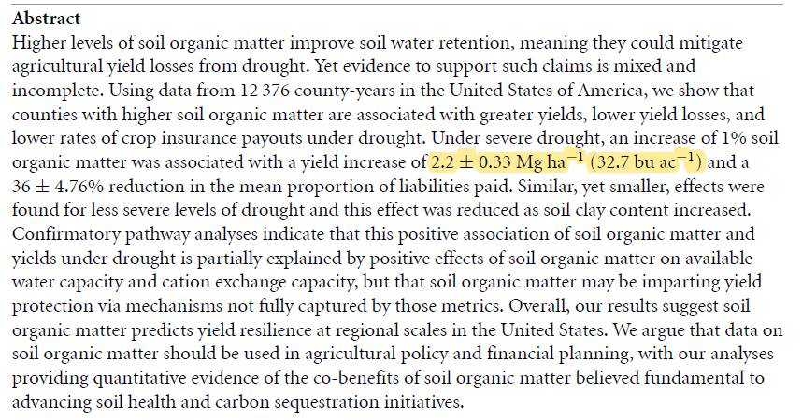

Slide 3
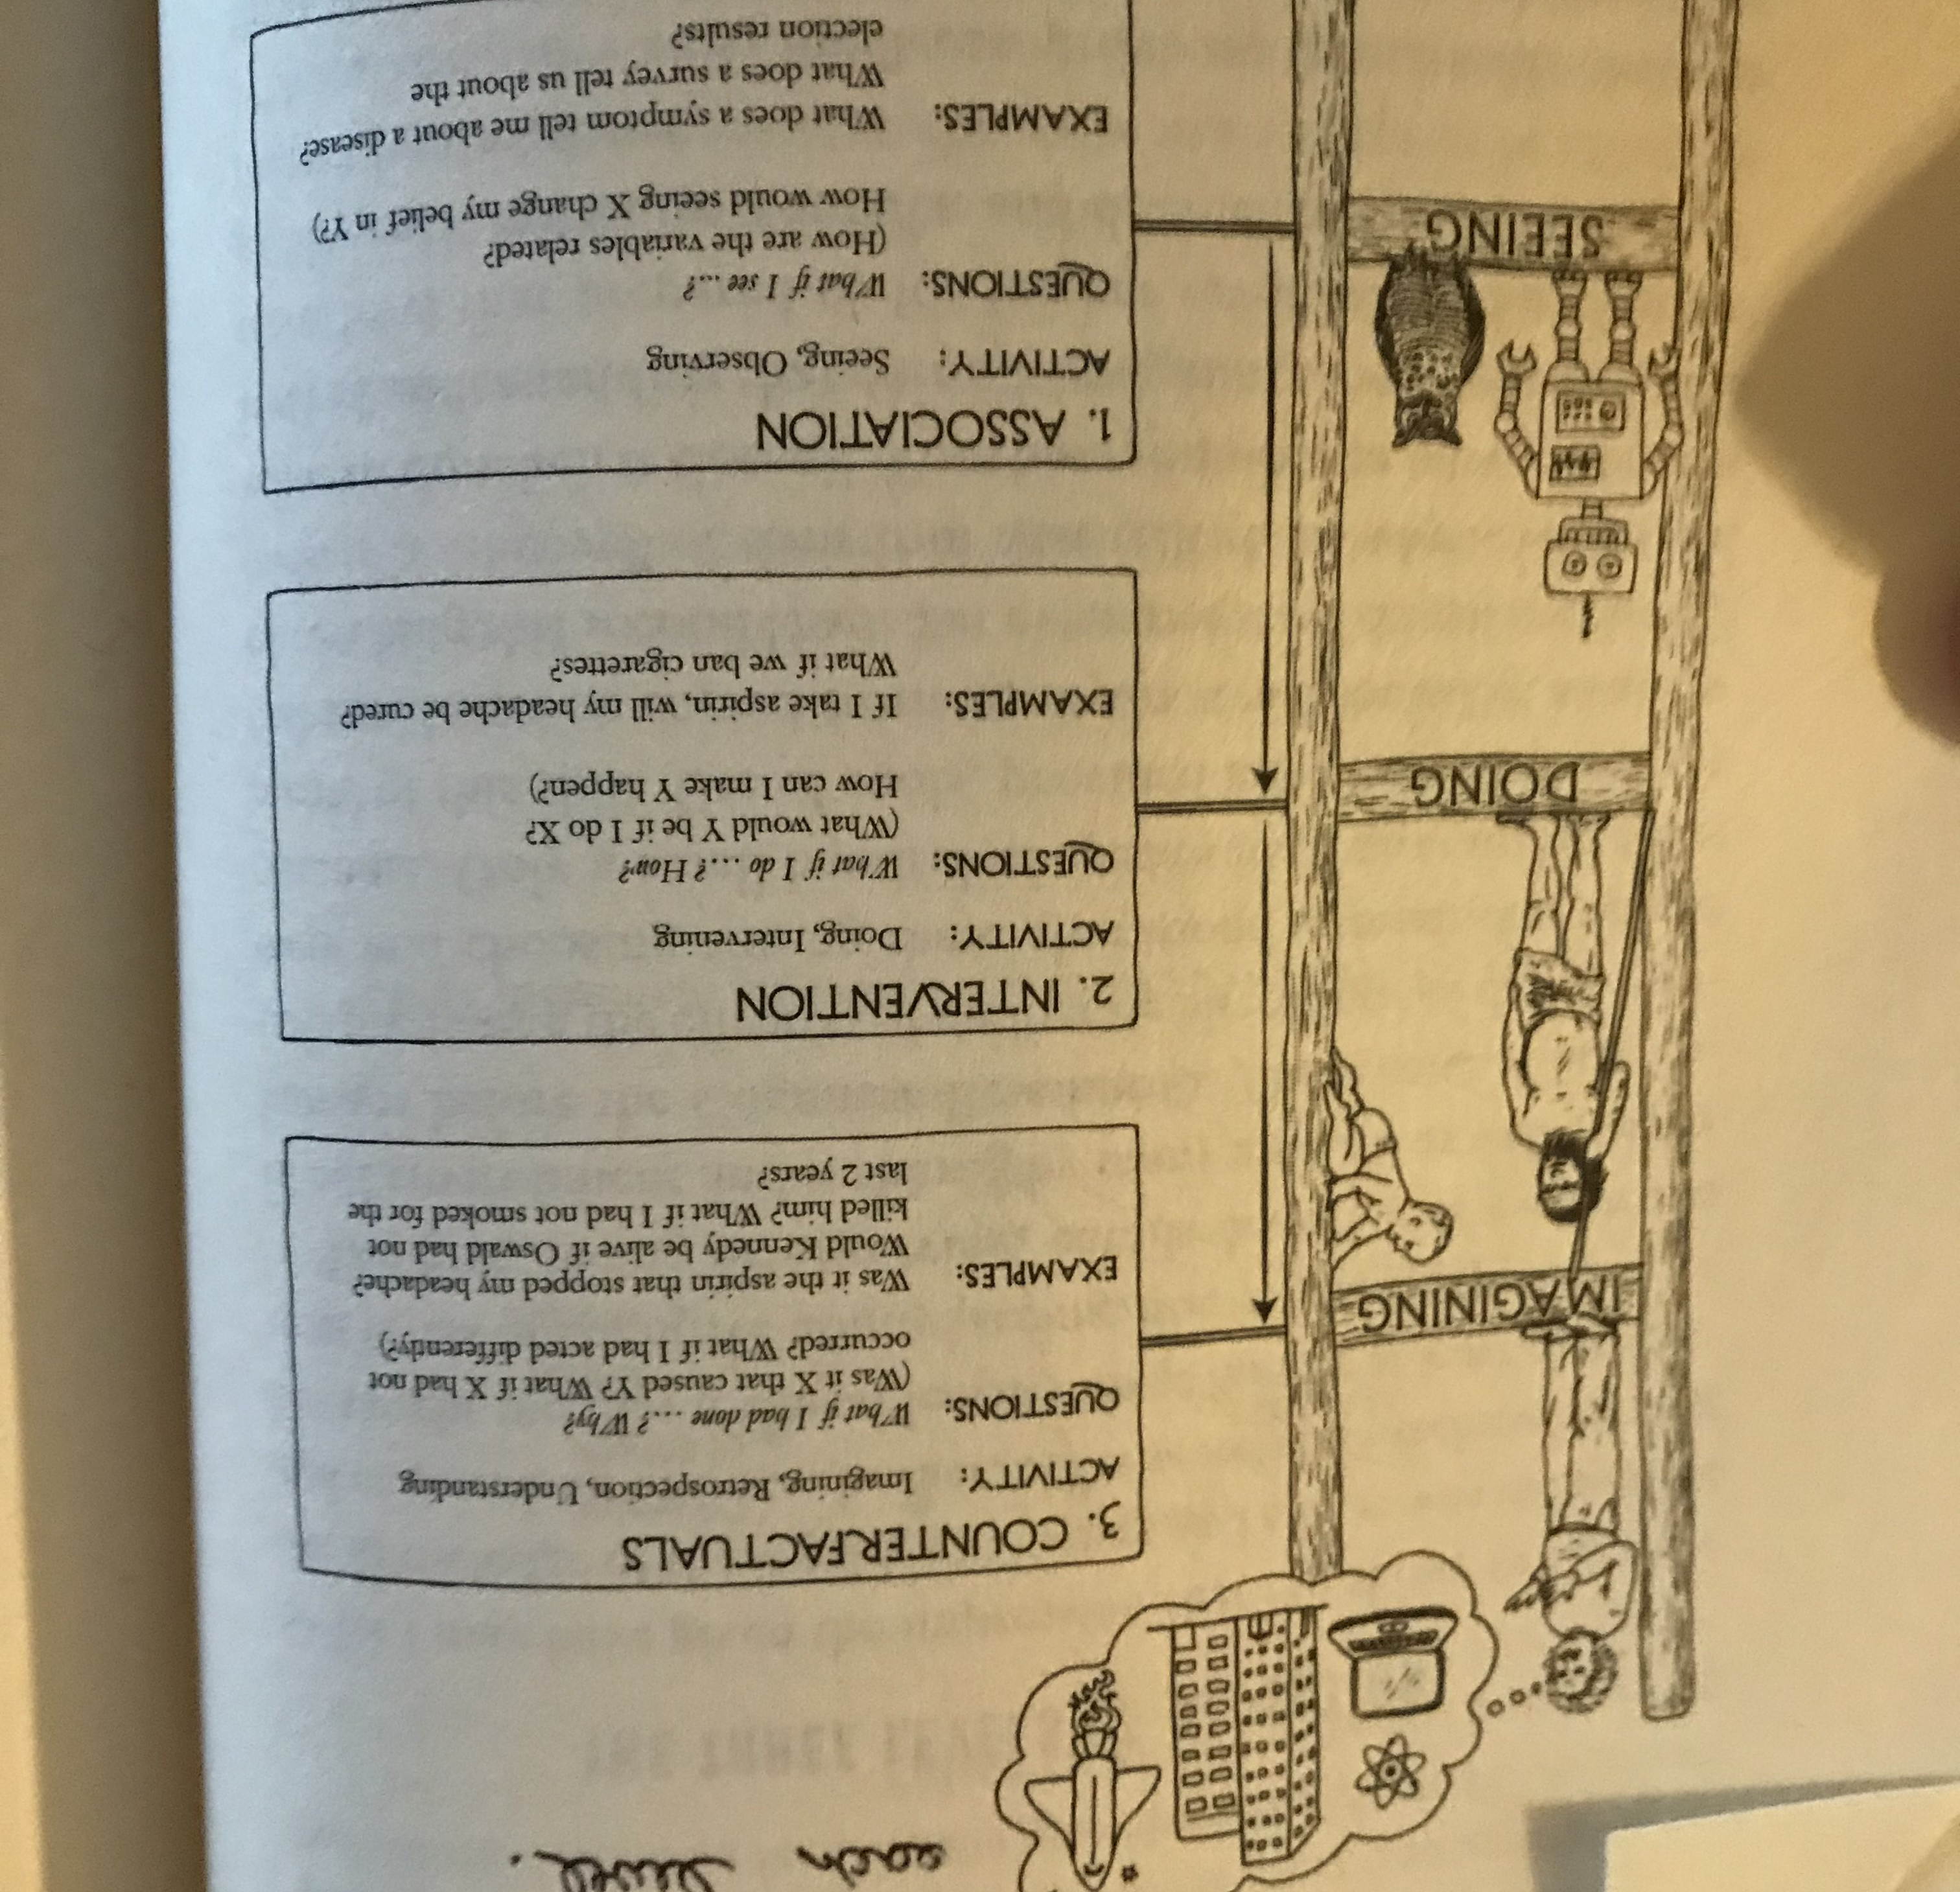

Slide 4
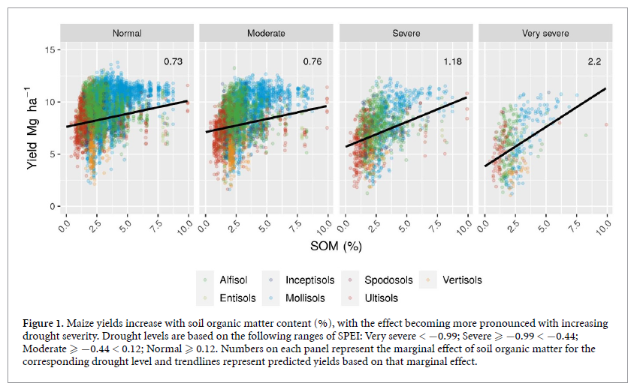
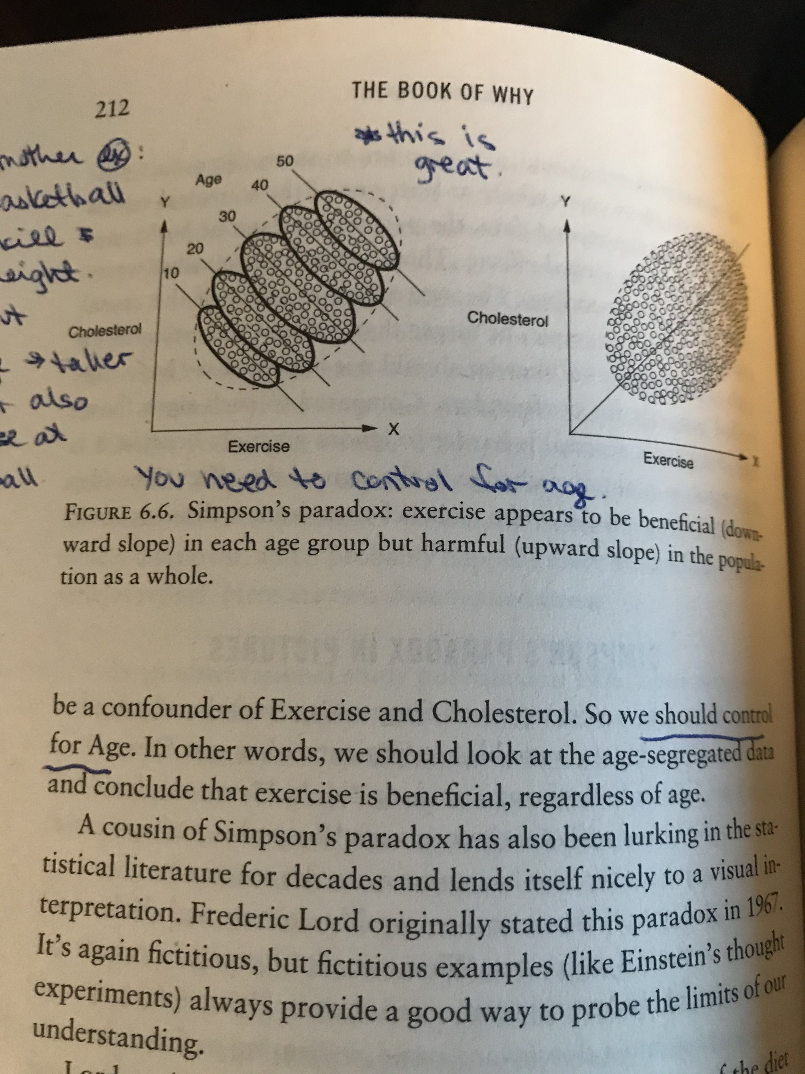
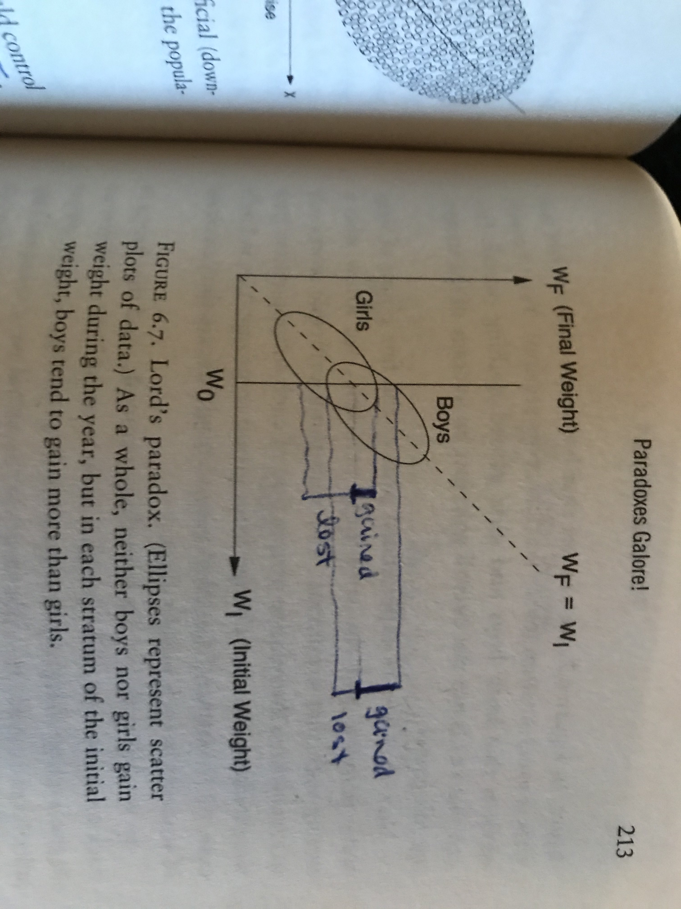

Slide 5
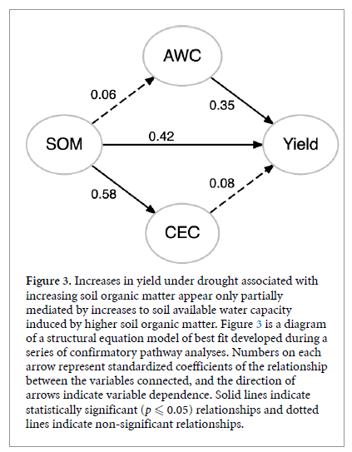

Slide 6
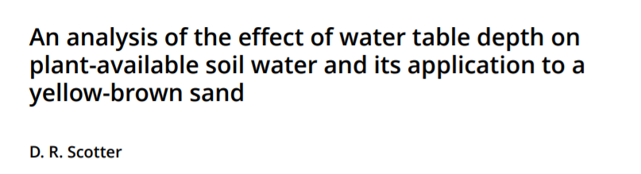
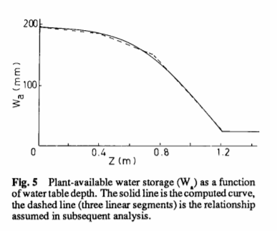
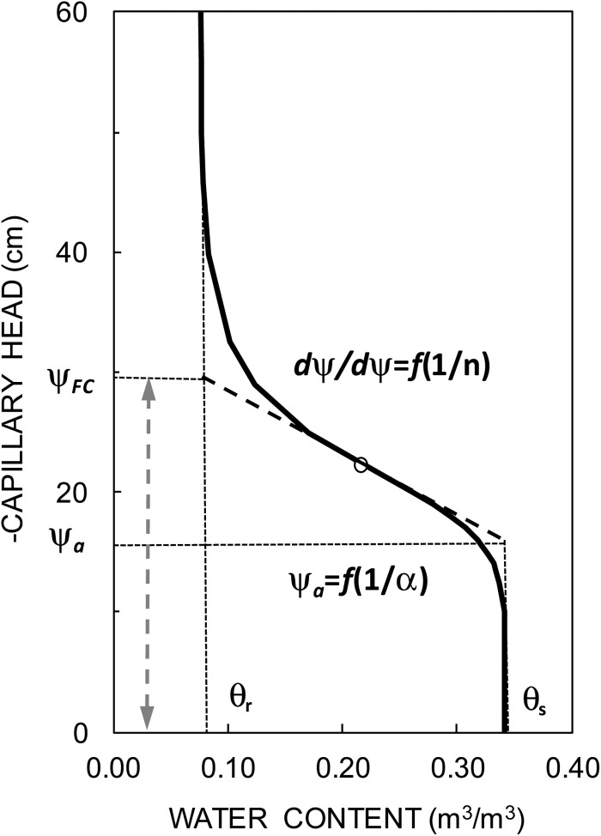
Depth to water table

Slide 7
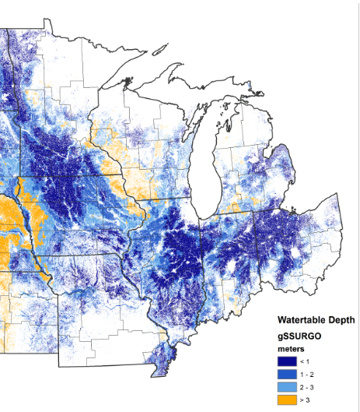
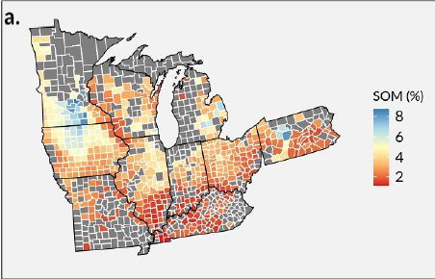

Slide 8
Depth to water table
Collider….
The collider would mean…
I think it means this value is being over estimated

Slide 9
Cover Crops
Above-ground biomass
Below-ground biomass
Soil Biology
Soil Erosion
Soil Organic Matter
Soil
aggregation
Soil porosity
Pore size distributions
Soil water at saturation
Soil water at field capacity

